Slide 1
CSS and SASS https://github.com/ruthlaird/advanced-css-course/tree/master/Natours
What I’ve learnt from the Natours project

Slide 2
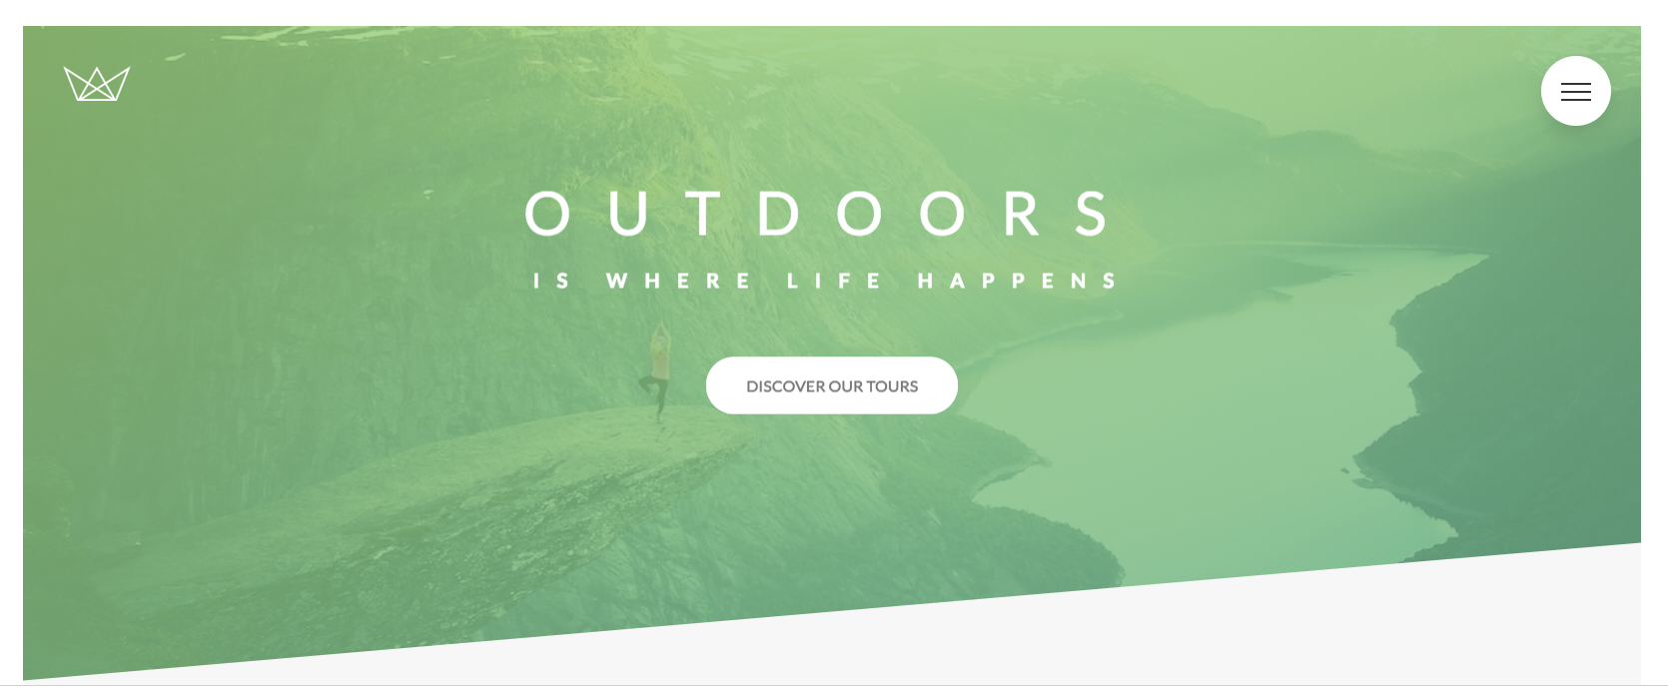
Header
background-image:
linear-gradient(to right bottom, rgba($start-color, 0.8), rgba($end- color, 0.8)), url($image-url); /* two images on top of each other */
background-size: cover; /* fits element inside width of the box */
clip-path: polygon(0 0, 100% 0, 100% 75vh, 0 100%);
co-ords to show clockwise from top left
(see https://bennettfeely.com/clippy/
for code for different polygon shapes)

Slide 3
Heading primary
@keyframes moveInLeft {
0% {
opacity: 0; /* invisible */
transform: translateX(-10rem); /* change x starting position */
}
80% {
transform: translateX(1rem);
}
100% {
opacity: 1;
transform: translate(0);
}
}
&--main {
animation-name: moveInLeft;
}
Under the hood this is a checkbox

Slide 4
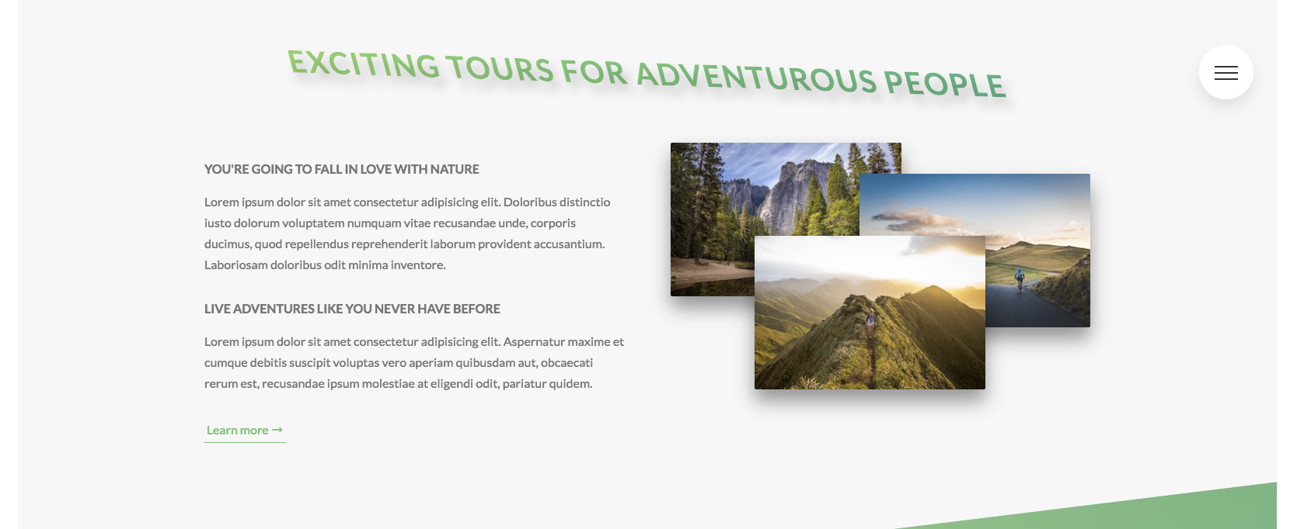
Heading Secondary
&:hover {
transform: skewY(2deg) skewX(15deg) scale(1.1);
text-shadow: .5rem 1rem 2rem rgba($color-black, .2);
}

Slide 5
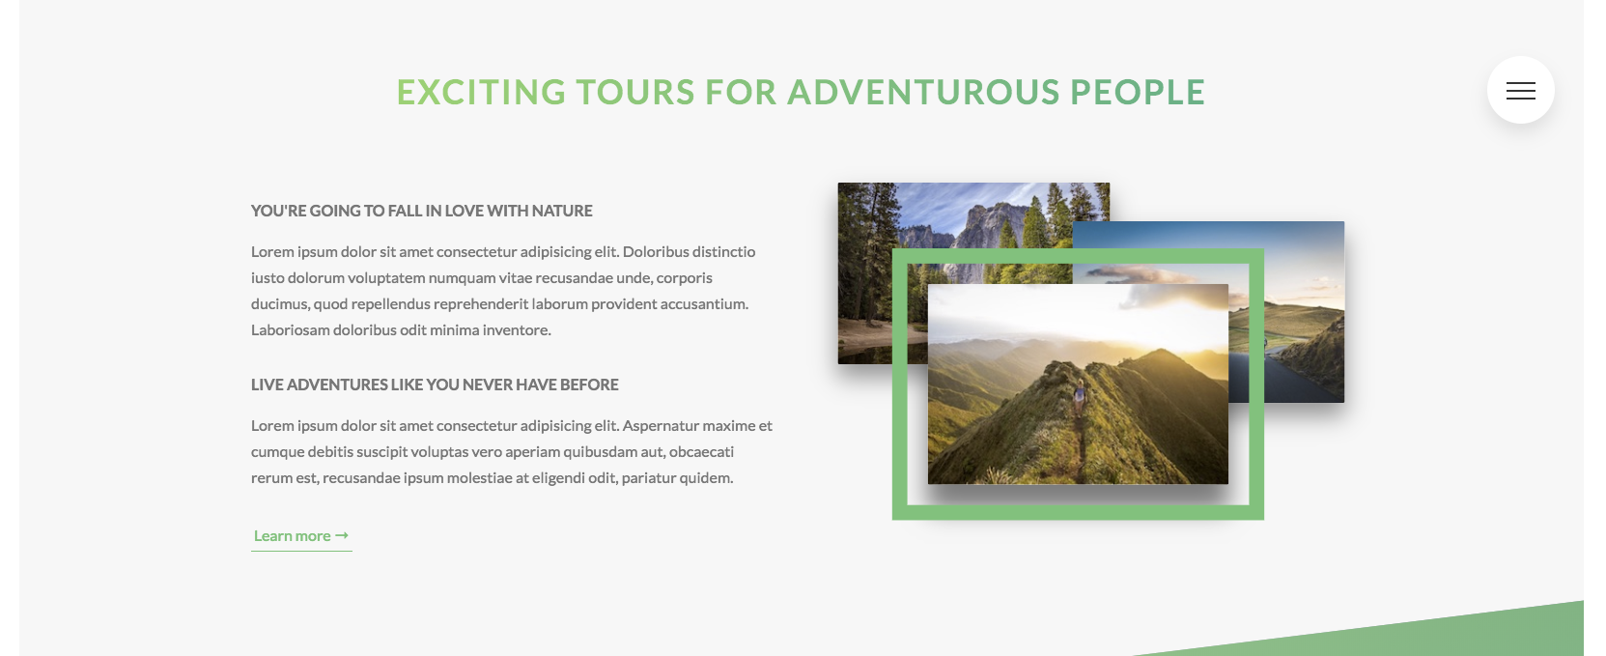
Composition
&:hover {
outline: 1.5rem solid $color-primary;
//like border but allows an offset to be specified which allows a gap between the border
transform: scale(1.05) translateY(-.5rem);
box-shadow: 0 2.5rem 4rem rgba($color-black, .5);
z-index: 20;
//by setting the z-index higher than those set above, it forces the image to appear on top
}

Slide 6
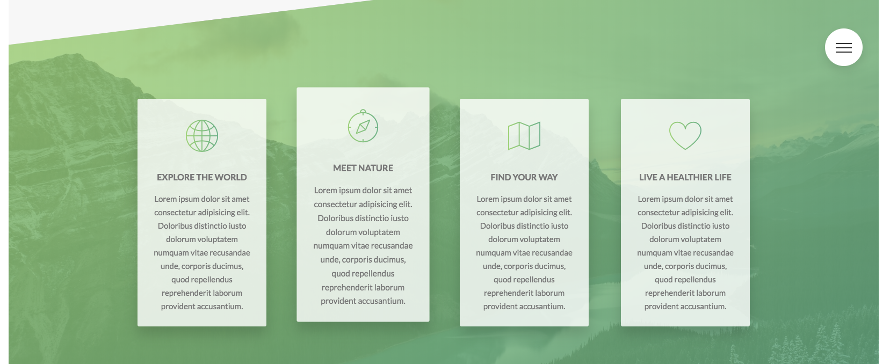
Feature box
.feature-box {
border-radius: $default-border-radius;
box-shadow: 0 1.5rem 4rem rgba($color-black, .15);
transition: transform .3s;
&:hover {
transform: translateY(-1.5rem) scale(1.03);
}

Slide 7
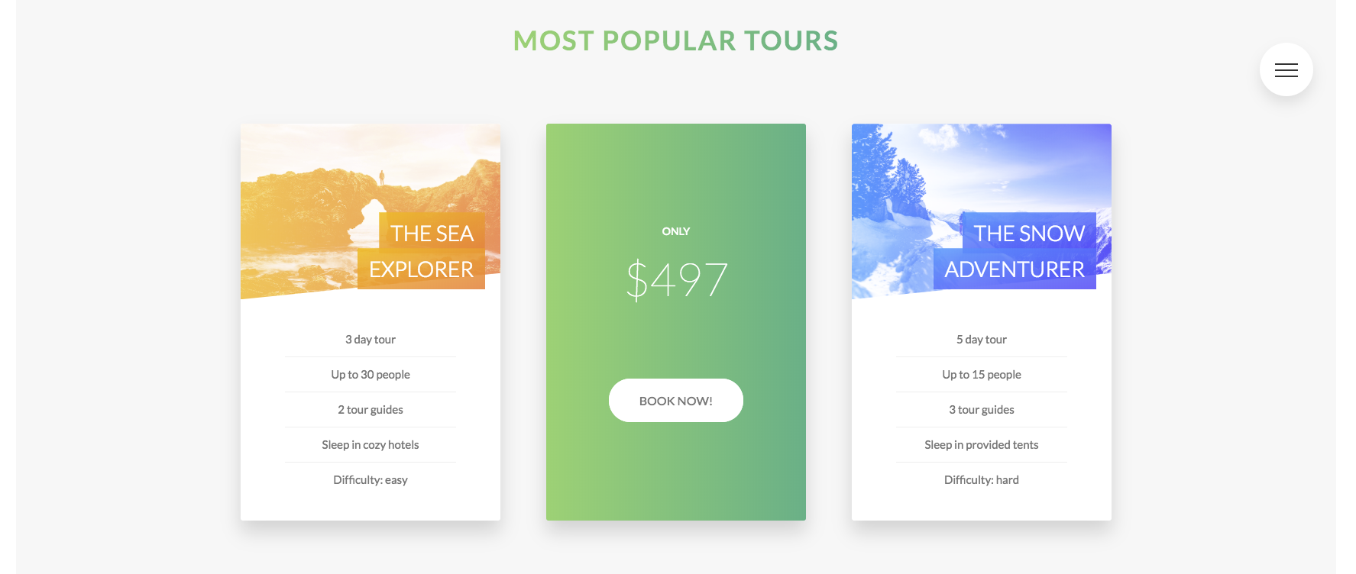
Card
&__side {
transition: all .8s ease;
position: absolute; // this has the effect of placing the front and back on top of each other
-webkit-backface-visibility: hidden;
backface-visibility: hidden; // hides the back part of the element as we have 2 elements on top of each other this has the effect of only showing one at once
border-radius: $default-border-radius;
overflow: hidden; // hides the part that overflows (ensures the image don't cover up the rounded border)
box-shadow: 0 1.5rem 4rem rgba($color-black, .15);

Slide 8
Card
&__picture {
background-size: cover; //scales the image as large as poss without stretching the image
height: 23rem;
background-blend-mode: screen; //how an element's background images should blend with each other and with the element's background color
-webkit-clip-path: polygon(0 0, 100% 0, 100% 85%, 0 100%);
clip-path: polygon(0 0, 100% 0, 100% 85%, 0 100%);
border-top-left-radius: $default-border-radius; //clip-path has removed the border-radiuses set in the parent so need to re-add them
border-top-right-radius: $default-border-radius;
&--1 {
background-image: linear-gradient(to right, $color-secondary-light, $color-secondary-dark),
url(../img/nat-5.jpg);

Slide 9
Card
&--back {
transform: rotateY(180deg);
}
&:hover &__side--front {
transform: rotateY(-180deg);
}
&:hover &__side--back {
transform: rotateY(0);
}

Slide 10
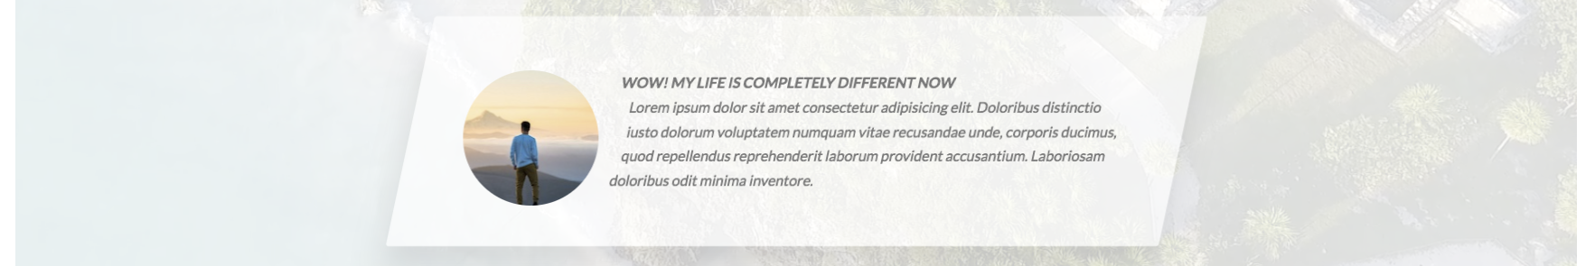
Story
&__shape {
width: 15rem;
height: 15rem;
float:left;
transform: translateX(-3rem) skewX(12deg);
position: relative;
border-radius: 50%;
@supports (clip-path: circle()) or (-webkit-clip-path: circle()) {
-webkit-clip-path: circle(50% at 50% 50%);
clip-path: circle(50% at 50% 50%);
-webkit-shape-outside: circle(50% at 50% 50%);
shape-outside: circle(50% at 50% 50%); //defines where the content flows outside the element
border-radius: none;
}
Graceful degradation – only applied if supported by browser

Slide 11
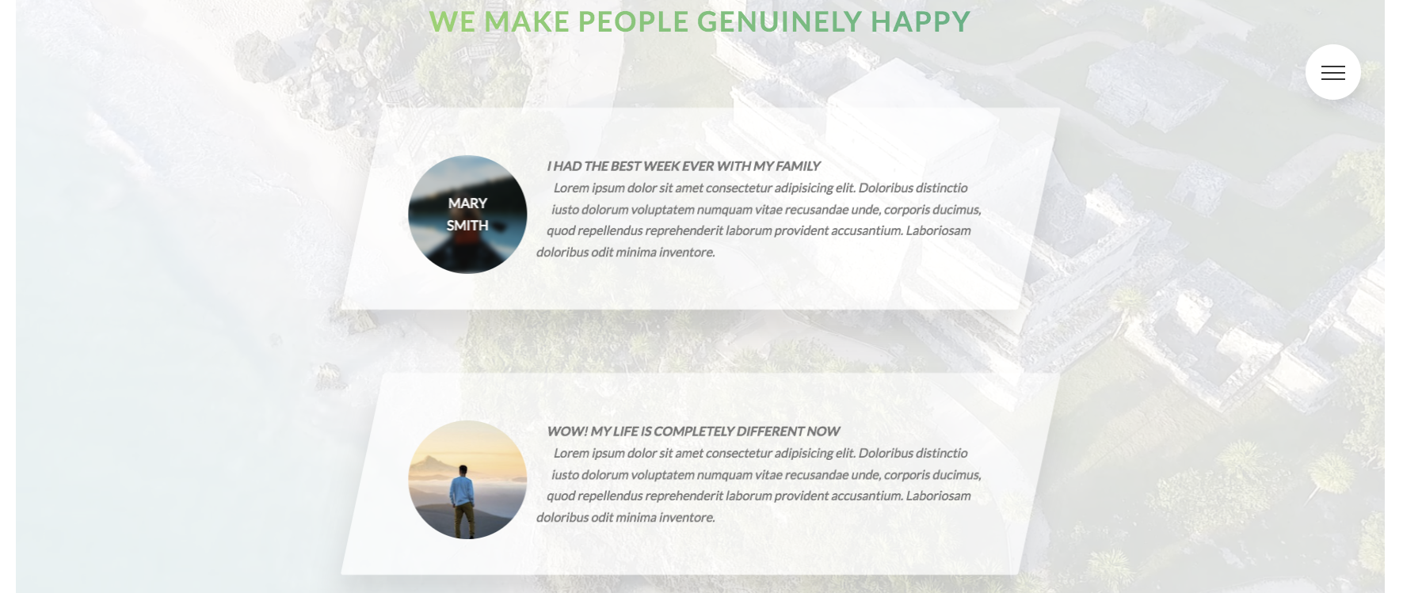
Story
&:hover &__caption {
opacity: 1;
transform: translate(-50%, -50%);
}
&:hover &__img {
transform: translateX(-4rem) scale(1);
filter: blur(3px) brightness(80%);
}

Slide 12
Story
<video class="bg-video__content" autoplay muted loop>
<source src="img/video.mp4" type="video/mp4">
<source src="img/video.webm" type="video/webm">
Your browser is not supported!
</video>
.bg-video {
position: absolute;
top: 0;
left: 0;
height: 100%;
width: 100%;
z-index: -1; //ensures it's behind all the other elements and can’t interact with it
opacity: .15;
overflow: hidden; //stops the video overflowing it's parent element
&__content {
height: 100%;
width: 100%;
object-fit: cover; //element fills the entire parent while maintaining it's aspect ratio
}
}

Slide 13
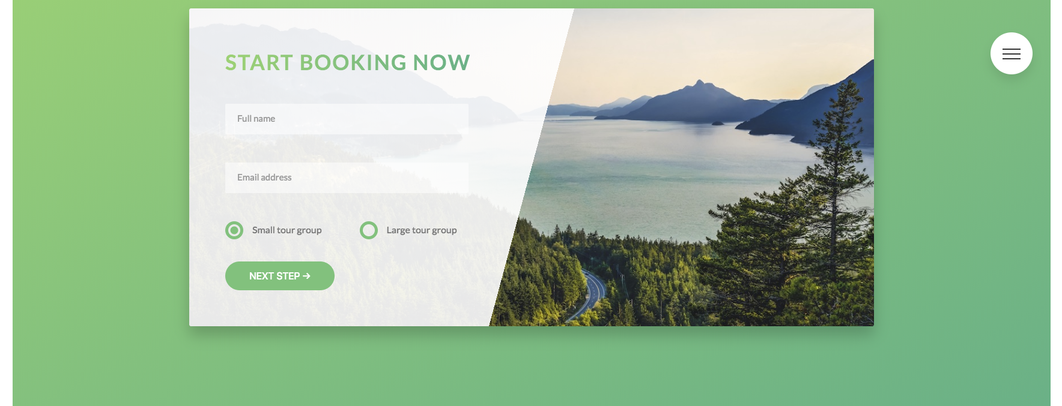
Booking
<input type="text" class="form__input" placeholder="Full name" id="name" required>
<label for="name" class="form__label">Full name</label>
&__input:placeholder-shown + &__label {
// + is used to specify the adjacent/next sibling,
// can also use ~ for a general sibling selector if there are more siblings in between
opacity: 0; //need to specify this as well as the visibility as want to animate the effect
visibility: hidden;
transform: translateY(-4rem);
}
custom radio buttons

Slide 14
Booking
&__radio-group {
width: 49%;
display: inline-block;
&__radio-input {
display: none;
}
&__radio-label {
font-size: $default-font-size;
cursor: pointer;
position: relative;
padding-left: 4.5rem;
}
&__radio-button {
height: 3rem;
width: 3rem;
border: 5px solid $color-primary;
border-radius: 50%;
display: inline-block;
position: absolute;
left: 0;
top: -.4rem;

Slide 15
Booking
&::after {
content: "";
display: block;
height: 1.3rem;
width: 1.3rem;
border-radius: 50%;
@include centerHorizontalVertical;
background-color: $color-primary;
opacity: 0;
transition: opacity .2s;
}
}
&__radio-input:checked ~ &__radio-label &__radio-button::after {
opacity: 1;
}

Slide 16
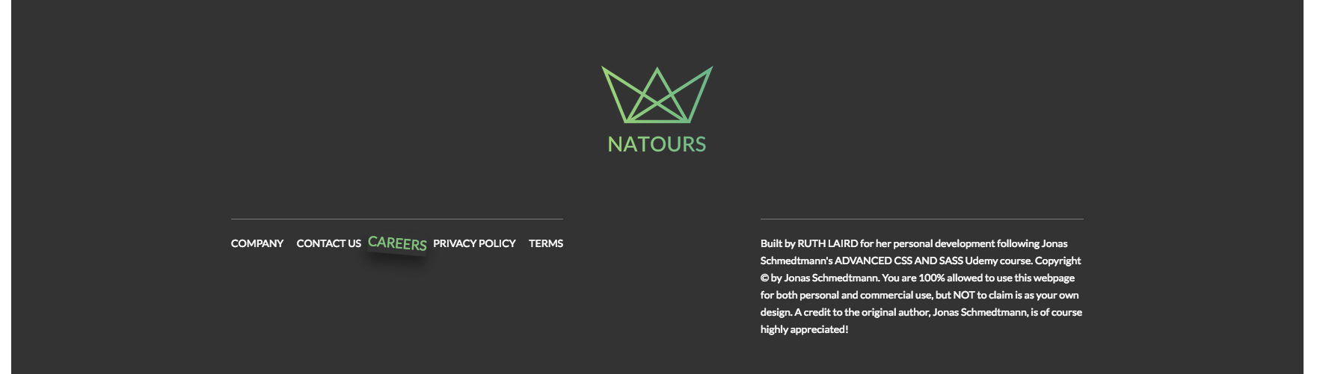
Footer
&__item {
display: inline-block;
&:not(:last-child) {
margin-right: 1.5rem;
}
}
&__link {
&:link,
&:visited {
color: $color-grey-light-1;
background-color: $color-grey-dark-3;
text-decoration: none;
text-transform: uppercase;
display: inline-block;
transition: all .2s;
}
&:hover,
&:active {
color: $color-primary;
box-shadow: 0 1rem 2rem rgba($color- black, .4);
transform: rotate(5deg) scale(1.3);
}
}

Slide 17
Responsive Design Strategies
max-width: 1200px
max-width: 900px
DESKTOP FIRST
Initial code goes here
max-width: 600px
0px
600px
900px
1200px
∞
MOBILE FIRST
Initial code goes here
min-width: 1200px
min-width: 900px
min-width: 600px

Slide 18
Responsive design – media queries
@mixin respond($breakpoint) {
@if $breakpoint == phone {
@media only screen and (max-width: 37.5em) { @content }; //600px
}
@if $breakpoint == tab-port {
@media only screen and (max-width: 56.25em) { @content }; //900px
}
@if $breakpoint == tab-land {
@media only screen and (max-width: 75em) { @content }; //1200px
}
@if $breakpoint == big-desktop {
@media only screen and (min-width: 112.5em) { @content }; //1800px
}
}
Use @content to pass block of code to a mixin
N.B. ‘rem’s don’t work in media queries in some browsers, so use ‘em’

Slide 19
Responsive design – media queries
Media queries don’t add any importance or specificity to selectors, so code order matters
put media queries at the end
Should ideally put breakpoints where design starts to look odd, otherwise use the most used screensizes as breakpoints
Put largest size media queries first in a desktop first strategy
Put smallest size media queries first in a mobile first strategy

